Slide 1
Introduction to Graphics Programming- OpenGL

Slide 2
OpenGL has it origins in the earlier GL (“Graphics Library”) system which was invented by Silicon Graphics Inc. as the means for programming their high-performance specialised graphics workstations.
As time went on, people became interested in porting GL to other kinds of machine, and in 1992 a variation of GL – called OpenGL – was announced.
Unlike GL, OpenGL was specifically designed to be platform-independent, so it would work across a whole range of computer hardware– not just Silicon Graphics machines.

Slide 3
The combination of OpenGL’s power and portability led to its rapid acceptance as a standard for computer graphics programming.
OpenGL itself isn’t a programming language, or a software library.
It’s the specification of an Application Programming Interface (API) for computer graphics programming.
In other words, OpenGL defines a set of functions for doing computer graphics.

Slide 4
The OpenGL API
Made up of GLU (which stands for the OpenGL utility library) and GLUT (an OpenGL Utility Toolkit).
GLU provides functions for drawing more complex primitives (All GLU function names start with ‘glu’.)
GLUT provides the facilities for interaction. It provides functions for managing windows on the display screen, and handling input events from the mouse and keyboard.

Slide 5
It provides some rudimentary tools for creating Graphical User Interfaces (GUIs).
It also includes functions for conveniently drawing 3D objects like the platonic solids (All GLUT function names start with ‘glut’)
OpenGL is designed to be a machine independent graphics library, but one that can take advantage of the structure of typical hardware accelerators for computer graphics

Slide 6
Major Elements in OpenGL Progamming
Geometric Primitives
The following are the basic building blocks any 3D model:
Points
Lines
Polygons
All Complex models are constructed from these geometric primitives

Slide 7
Points
A point represents a location in 3D space
Defined as (x, y,z)
Used as vertices, particle positions, and control points
Individual points can be generated by using the primitive type GL.GL POINTS.
With this primitive type, each vertex that is specified generates an individual point

Slide 8
By default, a point is drawn as a single pixel.
An individual pixel is just barely visible.
The size of a point can be increased by calling the function gl.glPointSize(size).
The parameter is a float that specifies the diameter of the point, in pixels.
The range of sizes that is supported depends on the implementation.

Slide 9
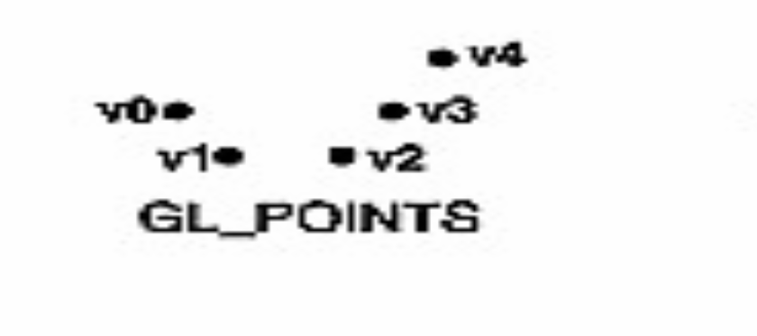

Slide 10
Lines
Defined using two points
Used in wireframe modeling, and geometry visualization
Types: line segment, infinite line, ray (starts at one point)
There are three primitive types for generating lines:
- GL.GL LINES,
- GL.GL LINE STRIP, and
- GL.GL LINE LOOP

Slide 11
GL_ LINES
The vertices that are specified are paired off, and each pair is joined to produce a line segment.
If the number of vertices is odd, the last vertex is ignored.
GL LINE STRIP
A line is drawn from the first specified vertex to the second, from the second to the third, from the third to the fourth, and so on.
GL LINE LOOP
Similar to GL LINE STRIP, except that one additional line segment is drawn from the final vertex back to the first.

Slide 12
By default, the width of a line is one pixel.
The width can be changed by calling gl.glLineWidth(width), where width is a value of type float that specifies the line width in pixels.
To get antialiased lines, you should call gl.glEnable(GL.GL LINE SMOOTH);
A line can also have an attribute called a stipple pattern which can be used to produce dotted and dashed lines.
The stipple pattern is set by calling gl.glLineStipple( multiplier, pattern );

Slide 13
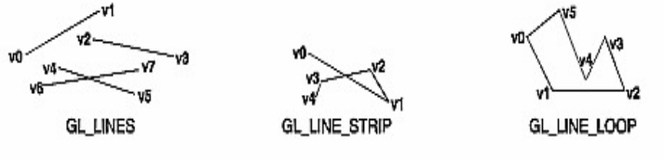

Slide 14
Polygons
These are closed shapes formed by formed by connecting multiple vertices
Common types: triangles, quadrilaterals, n‑gons
Triangles are the most important rendering primitive

Slide 15
Triangles
Triangles are particularly common in OpenGL.
When you build geometry out of triangles, you don’t have to worry about planarity or convexity, since every triangle is both planar and convex.
OpenGL has three primitive types for drawing triangles:
- GL.GL TRIANGLES
- GL.GL TRIANGLE STRIP, and
- GL.GL TRIANGLE FAN.

Slide 16
GL TRIANGLES
The vertices that you specify are grouped into sets of three
Every set of three generates a triangle.
If the number of vertices is not a multiple of three, then the one or two extra vertices are ignored.
One can, of course, use GL TRIANGLES to specify a single triangle by providing exactly three vertices.

Slide 17
GL TRIANGLE STRIP
The first three vertices specify a triangle, and each additional vertex adds another triangle, which is formed from the new vertex and the two previous vertices.
The triangles form a “strip” or “band” with the vertices alternating from one side of the strip to the other.

Slide 18
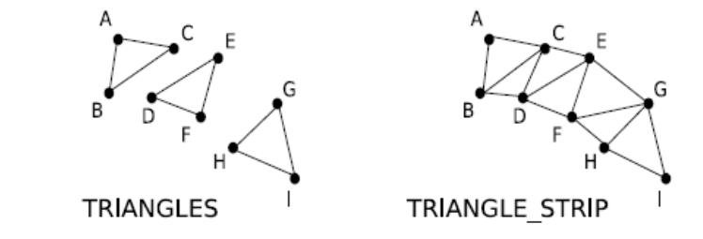

Slide 19
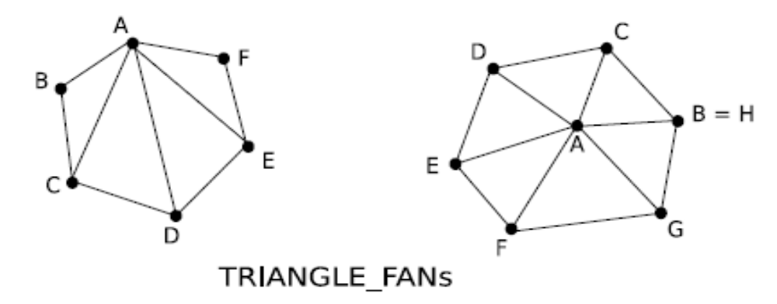
GL TRIANGLE FAN
It is less commonly used than the other two
In a triangle fan, the first vertex that is specified becomes one of the vertices of every triangle that is generated, and those triangles form a “fan” around that initial vertex.

Slide 20
Triangles are efficient for GPU processing and are fundamental rendering primitive used internally by modern graphics hardware

Slide 21
Quadrilaterals
A quadrilateral is a four-sided polygon.
As with any polygon in OpenGL, to be valid, a quadrilateral must be planar and convex.
Because of this restriction, it’s more common to use triangles than quads.
However, there are many common objects for which quads are appropriate.
OpenGL has two primitives for drawing quadrilaterals:
- GL.GL QUADS and
- GL.GL QUAD STRIP.

Slide 22
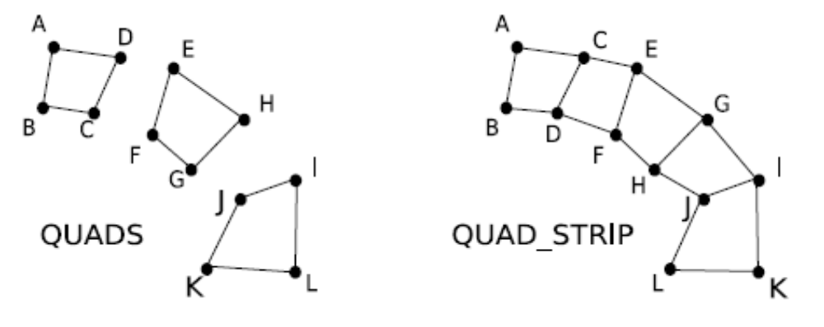
GL.GL QUADS
Draws a sequence of independent quadrilaterals, using groups of four vertices.
GL QUAD STRIP
draws a strip or band made up of quadrilaterals

Slide 23
Meshes
A mesh represents the surface of a 3D object
Composed of vertices, edges, and faces
Common mesh types: triangle mesh, quad mesh, polygon mesh

Slide 24
Mesh Components
Vertex: position, normal, texture coordinates
Edge: connection between two vertices
Face: surface element defined by vertices

Slide 25
Lab Activities
Create cube, sphere, and cylinder meshes
Switch between wireframe and solid modes
Manipulate vertices and observe deformation

Slide 26
Key Takeaways
3D models are built from primitives
Meshes represent object surfaces
Triangles are fundamental to rendering
Bézier, B‑Splines, and NURBS enable advanced curve and surface modeling

Slide 27
Example 1- Creating a Window
#include <GL/glut.h>
void display (void) { /* Called when OpenGL needs to update the display */
glClearColor(0.9,0.9,0.9,0.0); /* Set grey background */
glutInitWindowSize (500, 500); /* Set the window size */
glutInitWindowPosition (100, 100); /* Set the window position */
glClear (GL_COLOR_BUFFER_BIT); /* Clear the window */
glFlush(); /* Force update of screen */
}
int main (int argc, char **argv) {
glutInit (&argc, argv); /* Initialise OpenGL */
glutCreateWindow ("My Gray Window"); /* Create the window */
glutDisplayFunc (display); /* Register the "display" function */
glutMainLoop (); /* Enter the OpenGL main loop */
return 0;
}

Slide 28
1. The program begins with #include <GL/glut.h>
All OpenGL programs must start with this line, which accesses all the OpenGL include files:
It pulls in all the function prototypes and other definitions used by OpenGL.
The program cannot compile without it.

Slide 29
2. int main(int argc, char **argv)
Argc and argv should be the arguments of the application’s main() method
3. glutInit (&argc, argv)
glutInit() initializes the GLUT library, and it must be called before any other GLUT function
4. glutInitWindowSize (800, 500);
glutInitWindowSize() sets the value of GLUT’s initial window size to the size specified by width and height, measured in pixels.

Slide 30
This command specifies the desired width and height of the graphics window.
The general form is glutInitWindowSize(int width, int height).
The values are given in numbers of pixels.
5. glutInitWindowPosition (100, 100);
glutInitWindowPosition() sets the value of GLUT’s initial window position

Slide 31
glutInitWindowPosition ( int x,int y ) - x and y give the position of the top left corner of the window measured in pixels from the top left corner of the X display.
6. glutCreateWindow ("My Gray Window"); -int glutCreateWindow ( char *name );
glutCreateWindow() creates an OpenGL window for rendering and interaction, with name displayed in its titlebar.
GLUT assigns this window an integer identifier, returned as the result of the function.

Slide 32
The window identifier is used when writing OpenGL programs which use multiple windows.
glutInitWindowSize() and glutInitWindowPosition() arguments control the size and position of the window
7. glClearColor(0.9,0.9,0.9,0.0); /* Set grey backbround */

Slide 33
8. glClear ( GLbitfield mask );- glClear (GL_COLOR_BUFFER_BIT);-
glClear() clears one or more of OpenGL’s buffers, specified by mask. e.g the frame buffer, which holds the pixels which will be copied to the window.
This has the special name GL COLOR BUFFER BIT. When glClear() is called, each pixel in the buffer is set to the current clear colour, which is set to black by default.
We set the current clear colour using the function glClearColor()

Slide 34
9. glColor3f(1.0,0.0,0.0);
The command glColor3f() sets the drawing color.
The arguments are three GLfloat’s, giving the R, G, and B components of the color.
In this case, RGB = (1;0;0) means pure red.
The suffix “3f” means that three floating point arguments (actually GLfloat’s) will be given.

Slide 35
For example, glColor3d() takes three double (or GLdouble) arguments, glColor3ui() takes three unsigned int arguments, and so on.
For floats and doubles, the arguments range from 0 (no intensity) to 1 (full intensity).
For integer types (byte, short, int, long) the input is assumed to be in the range from 0 (no intensity) to its maximum possible positive value (full intensity).

Slide 36
Specifying a Color With OpenGL, the description of the shape of an object being drawn is independent of the description of its color.
Whenever a particular geometric object is drawn, it's drawn using the currently specified coloring scheme.
The coloring scheme might be as simple as "draw everything in fire-engine red," or might be as complicated as "assume the object is made out of blue plastic, that there's a yellow spotlight pointed in such and such a direction, and that there's a general low-level reddish-brown light everywhere else."

Slide 37
In general, an OpenGL programmer first sets the color or coloring scheme, and then draws the objects.
Until the color or coloring scheme is changed, all objects are drawn in that color or using that coloring scheme. This method helps OpenGL achieve higher drawing performance than would result if it didn’t keep track of the current color.

Slide 38
glColor3f(0.0, 0.0, 0.0); black
glColor3f(1.0, 0.0, 0.0); red
glColor3f(0.0, 1.0, 0.0); green
glColor3f(1.0, 1.0, 0.0); yellow
glColor3f(0.0, 0.0, 1.0); blue
glColor3f(1.0, 0.0, 1.0); magenta
glColor3f(0.0, 1.0, 1.0); cyan
glColor3f(1.0, 1.0, 1.0); white

Slide 39
10. glFlush();
The purpose of this function is to instruct OpenGL to make sure the screen is up to date – it causes the contents of any internal OpenGL buffers are “flushed” to the screen.
11. glutMainLoop (); /*Enter the OpenGL main loop */
glutMainLoop() starts the GLUT “event processing” loop: Once started, this loop will carry on for as long as the program is running. Each time around the loop, GLUT checks to see if anything has changed since last time, and calls the appropriate callback functions.

